Slide 1


#WEBINARSUNIA
Beyond Annotation
Learning through Close
Reading of Media Texts
Ponente: DR. KURT FENDT
Conductora: María Sánchez (Innovación UNIA)
Fecha: 21/06/2021
Webinars sobre e-learning, innovación y competencias digitales. Plan de formación y apoyo al profesorado 2021-22
Área de Innovación (@uniainnova)/ Vicerrectorado de Innovación Docente y Digitalización. Universidad Internacional de Andalucía

Slide 2

Kurt Fendt
Senior Lecturer
Comparative Media Studies/Writing
Massachusetts Institute of Technology
Cambridge, MA, USA
@fendt, fendt@mit.edu

Slide 3
Agenda
Why Annotation?
1
History and praxis of annotation
Forms of annotation
- Its connection to writing & learning
Pedagogical Value of Annotation
2
- Close reading vs. distant reading
- Deeper engagement of learners
- Students as editors/scholars
Annotation in the Classroom
3
Three case studies
Annotation platforms
Annotation Studio (examples)
Beyond Annotation
4
Closing the reading-annotation-writing cycle
Discussion of integration of annotation into the classroom

Slide 4
Annotation is deeply connected to reading, writing, scholarship, and learning.
Marginal annotation is a highly developed activity and as old as reading itself.
Annotations are the visible traces of the reading process.
It blurs the boundaries between readers and writers.

Slide 5
1. Why Annotation
Let’s look at the
History and praxis of annotation.
Forms and Functions of annotation
Connections between writing & learning

Slide 6
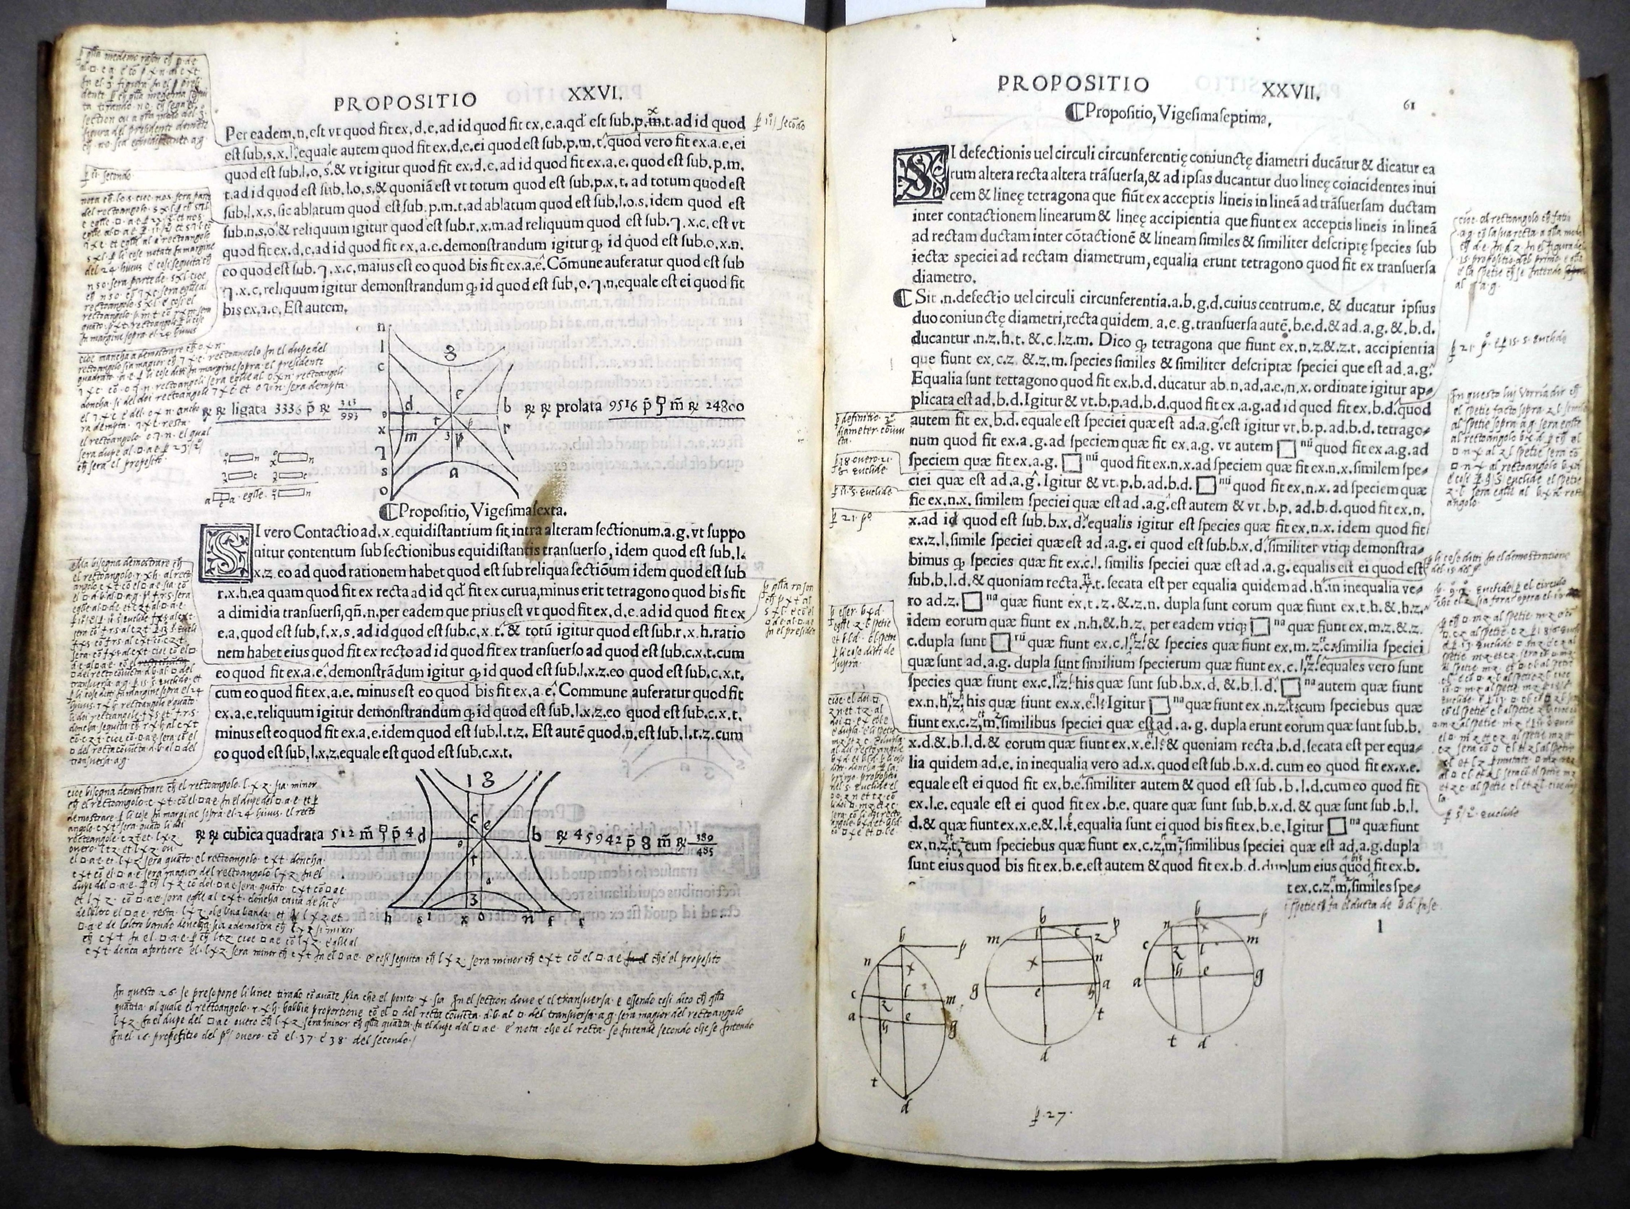
Latin translation of Apollonius of Perga’s classical Greek text on conic sections, Venice 1537

Slide 7
Annotation in manuscripts and early printed books
Very few readers
Long period of time
Public activity
Books were precious objects, often with only very few copies, and only few people were able to read.
Marginalia (notes in the margins) built up over time and created a dialogue over time, layering different reader perspectives and information.
Annotations were not only personal notes but added layered explanations, interpretations, critique, information, etc.

Slide 8
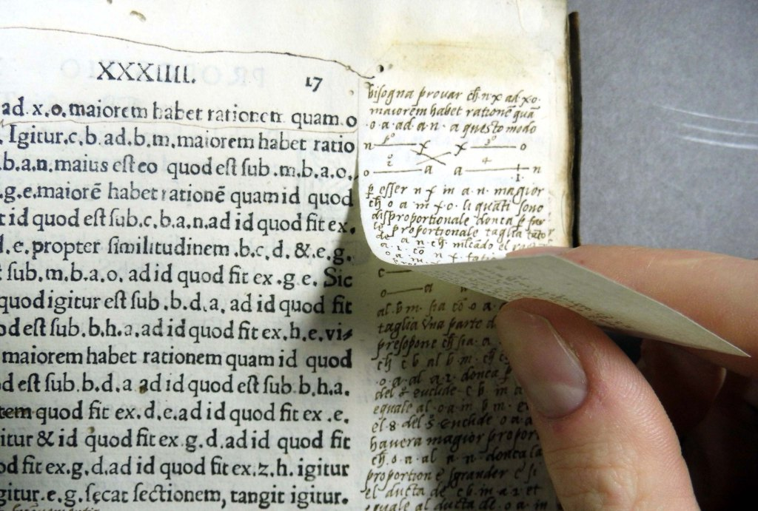
Latin translation of Apollonius of Perga’s classical Greek text on conic sections, Venice 1537

Slide 9
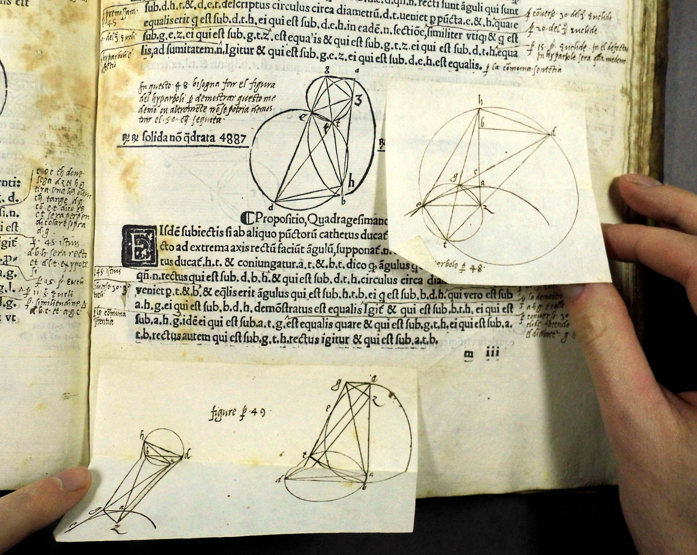
Latin translation of Apollonius of Perga’s classical Greek text on conic sections, Venice 1537

Slide 10
Annotation created a dialogue not only between reader and text but also between readers.
A prime example of this dialogue embedded in print is the Talmud.
A modern example is Doug Dorst and J. J. Abrams’ 2013 book:
S. - Ship of Theseus.

Slide 11
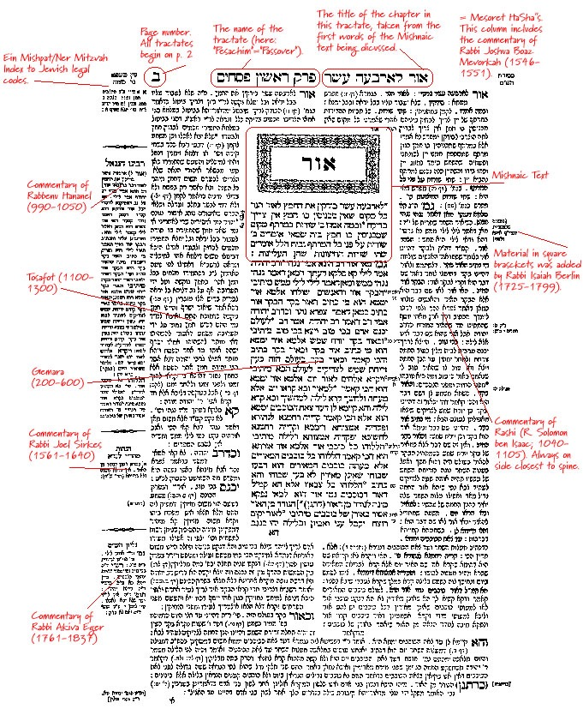

Slide 12
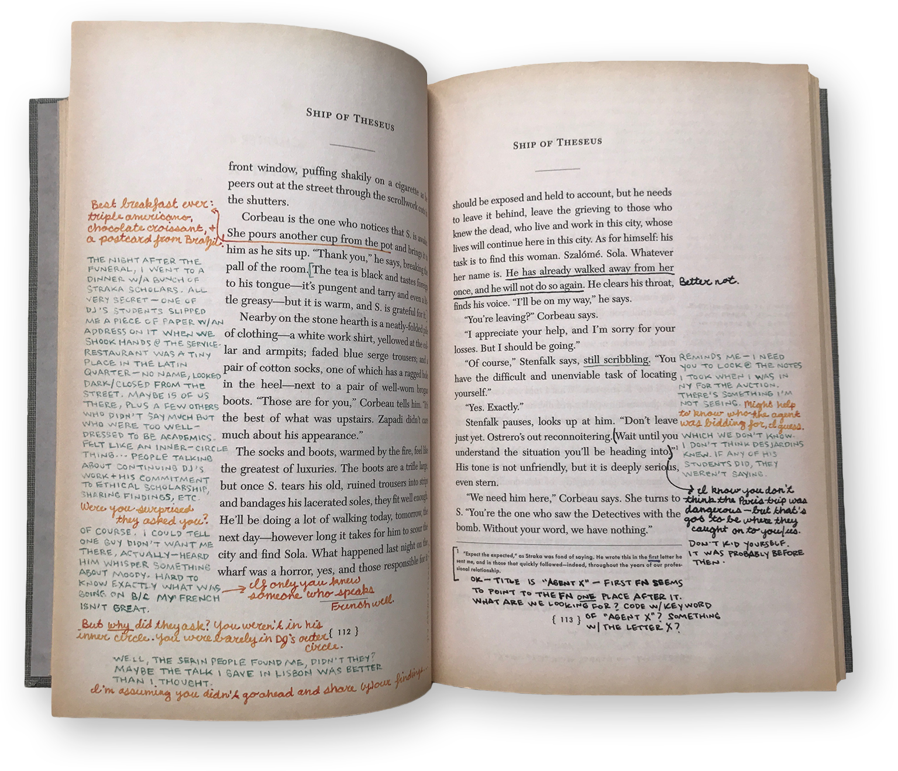
S. - Ship of Theseus by Doug Dorst and J. J. Abrams, 2013

Slide 13
Annotations reveal the reading and thinking process.
Let’s look at Herman Melville’s revision process in his manuscript of Billy Budd.
He reads, re-reads, and edits at the same time.

Slide 14
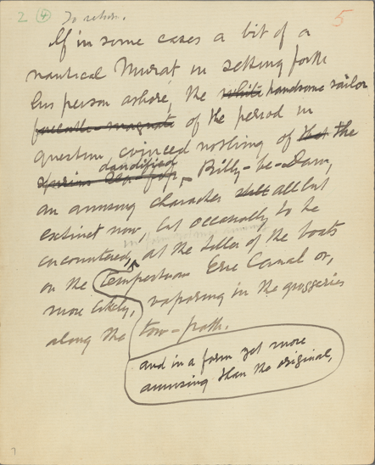

the white forecastle-magnate
the [. . .] forecastle-magnate
the [. . .] handsome sailor
Herman Melville: Billy Budd Manuscript, Leaf 7, Handsome Sailor, Revision Sequence 1 (John Bryant, Hofstra University)

Slide 15
the white forecastle-magnate
the white handsome forecastle-magnate
the white handsome forecastle-magnate
the white handsome sailor
the […] handsome sailor
Herman Melville: Billy Budd Manuscript, Leaf 7, Handsome Sailor, Revision Sequence 2 (John Bryant, Hofstra University)

Slide 16
Annotations can link to internal and external references.
Early technology innovators such as Vannevar Bush and his Memex or Theodor Nelson’s concept of the Docuverse were inspired by the praxis of annotation.

Slide 17
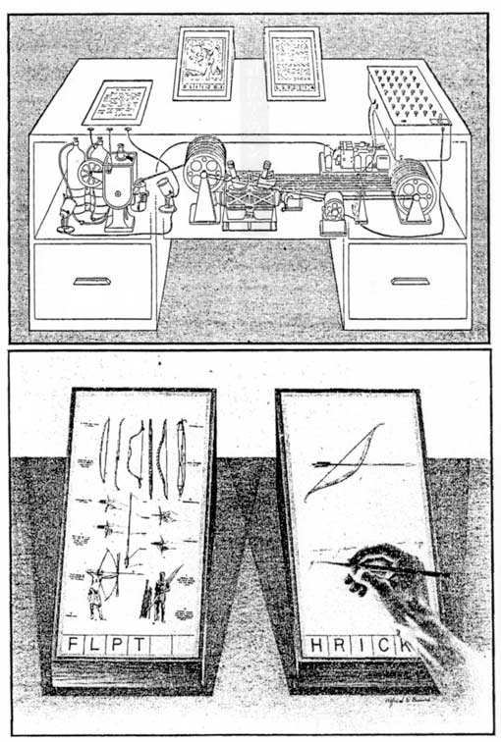
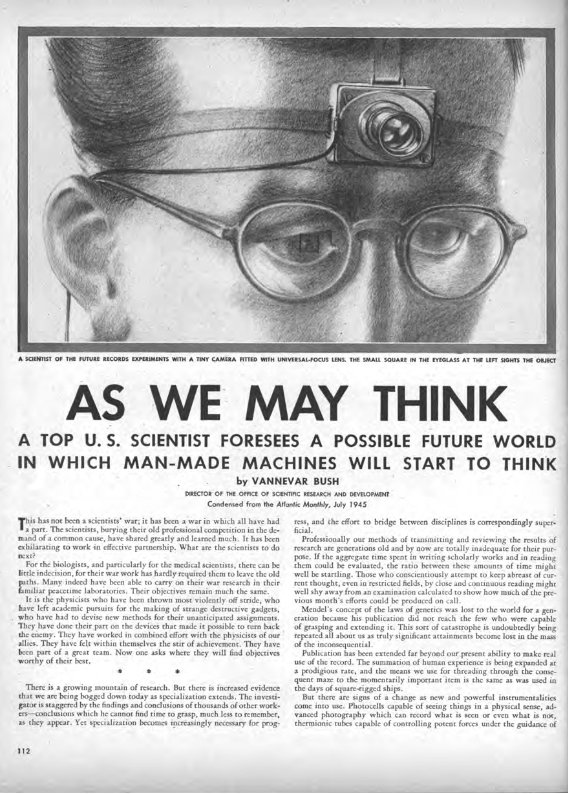
Vannevar Bush “As We may Think”, July 1945, Atlantic Monthly

Slide 18
Theodor Holm Nelson: Literary Machines, 93.1, 1993

Slide 19
Forms and functions of annotations.
Annotations can take on many forms and serve multiple functions on all kinds of (media) texts.

Slide 20
Functions of
Annotations
Annotations are created in service of different activities and with different expectations about audience and future use.
In modern paper books, annotations are a personal device that highlight reading as a visible trace of human attention.
A visible connection exists between text, reader, commentary, and potential future readers.
Annotations have value beyond their original purpose.
What changes/remains the same when we move annotation into the digital space?

Slide 21
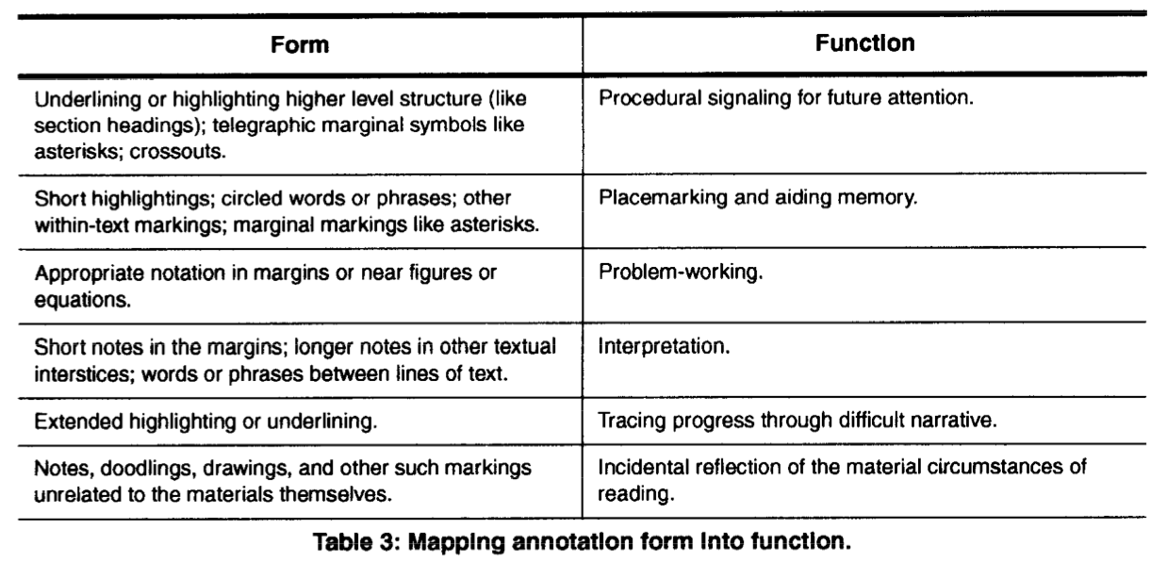
Form and Functions
of Annotations
Catherine C. Marshall (1997) Annotation: From Paper Books
to the Digital Library

Slide 22
Readers as
Writers.
Reading and writing are closely linked. Annotating turns reading into an active, kinetic process.

Slide 23
Readers as
Writers
Annotations decentralize authority.
Annotations are a form of collaboration across time, texts, and readers
-> social annotation.
Readers as editors.
Readers as scholars.

Slide 24
Annotating
Digitally.
Annotating in digital spaces reclaims some of the functions of marginalia in manuscripts.
It turns it into a social and collaborative activity.

Slide 25
Annotation in the
Digital Space
Annotations contextualize content.
Annotations as reference to other (multimedia materials).
Annotations shift flexibly from private to shared (public).
Annotations on static (text, images) and dynamic (audio, video).
Annotations become procedural themselves.

Slide 26
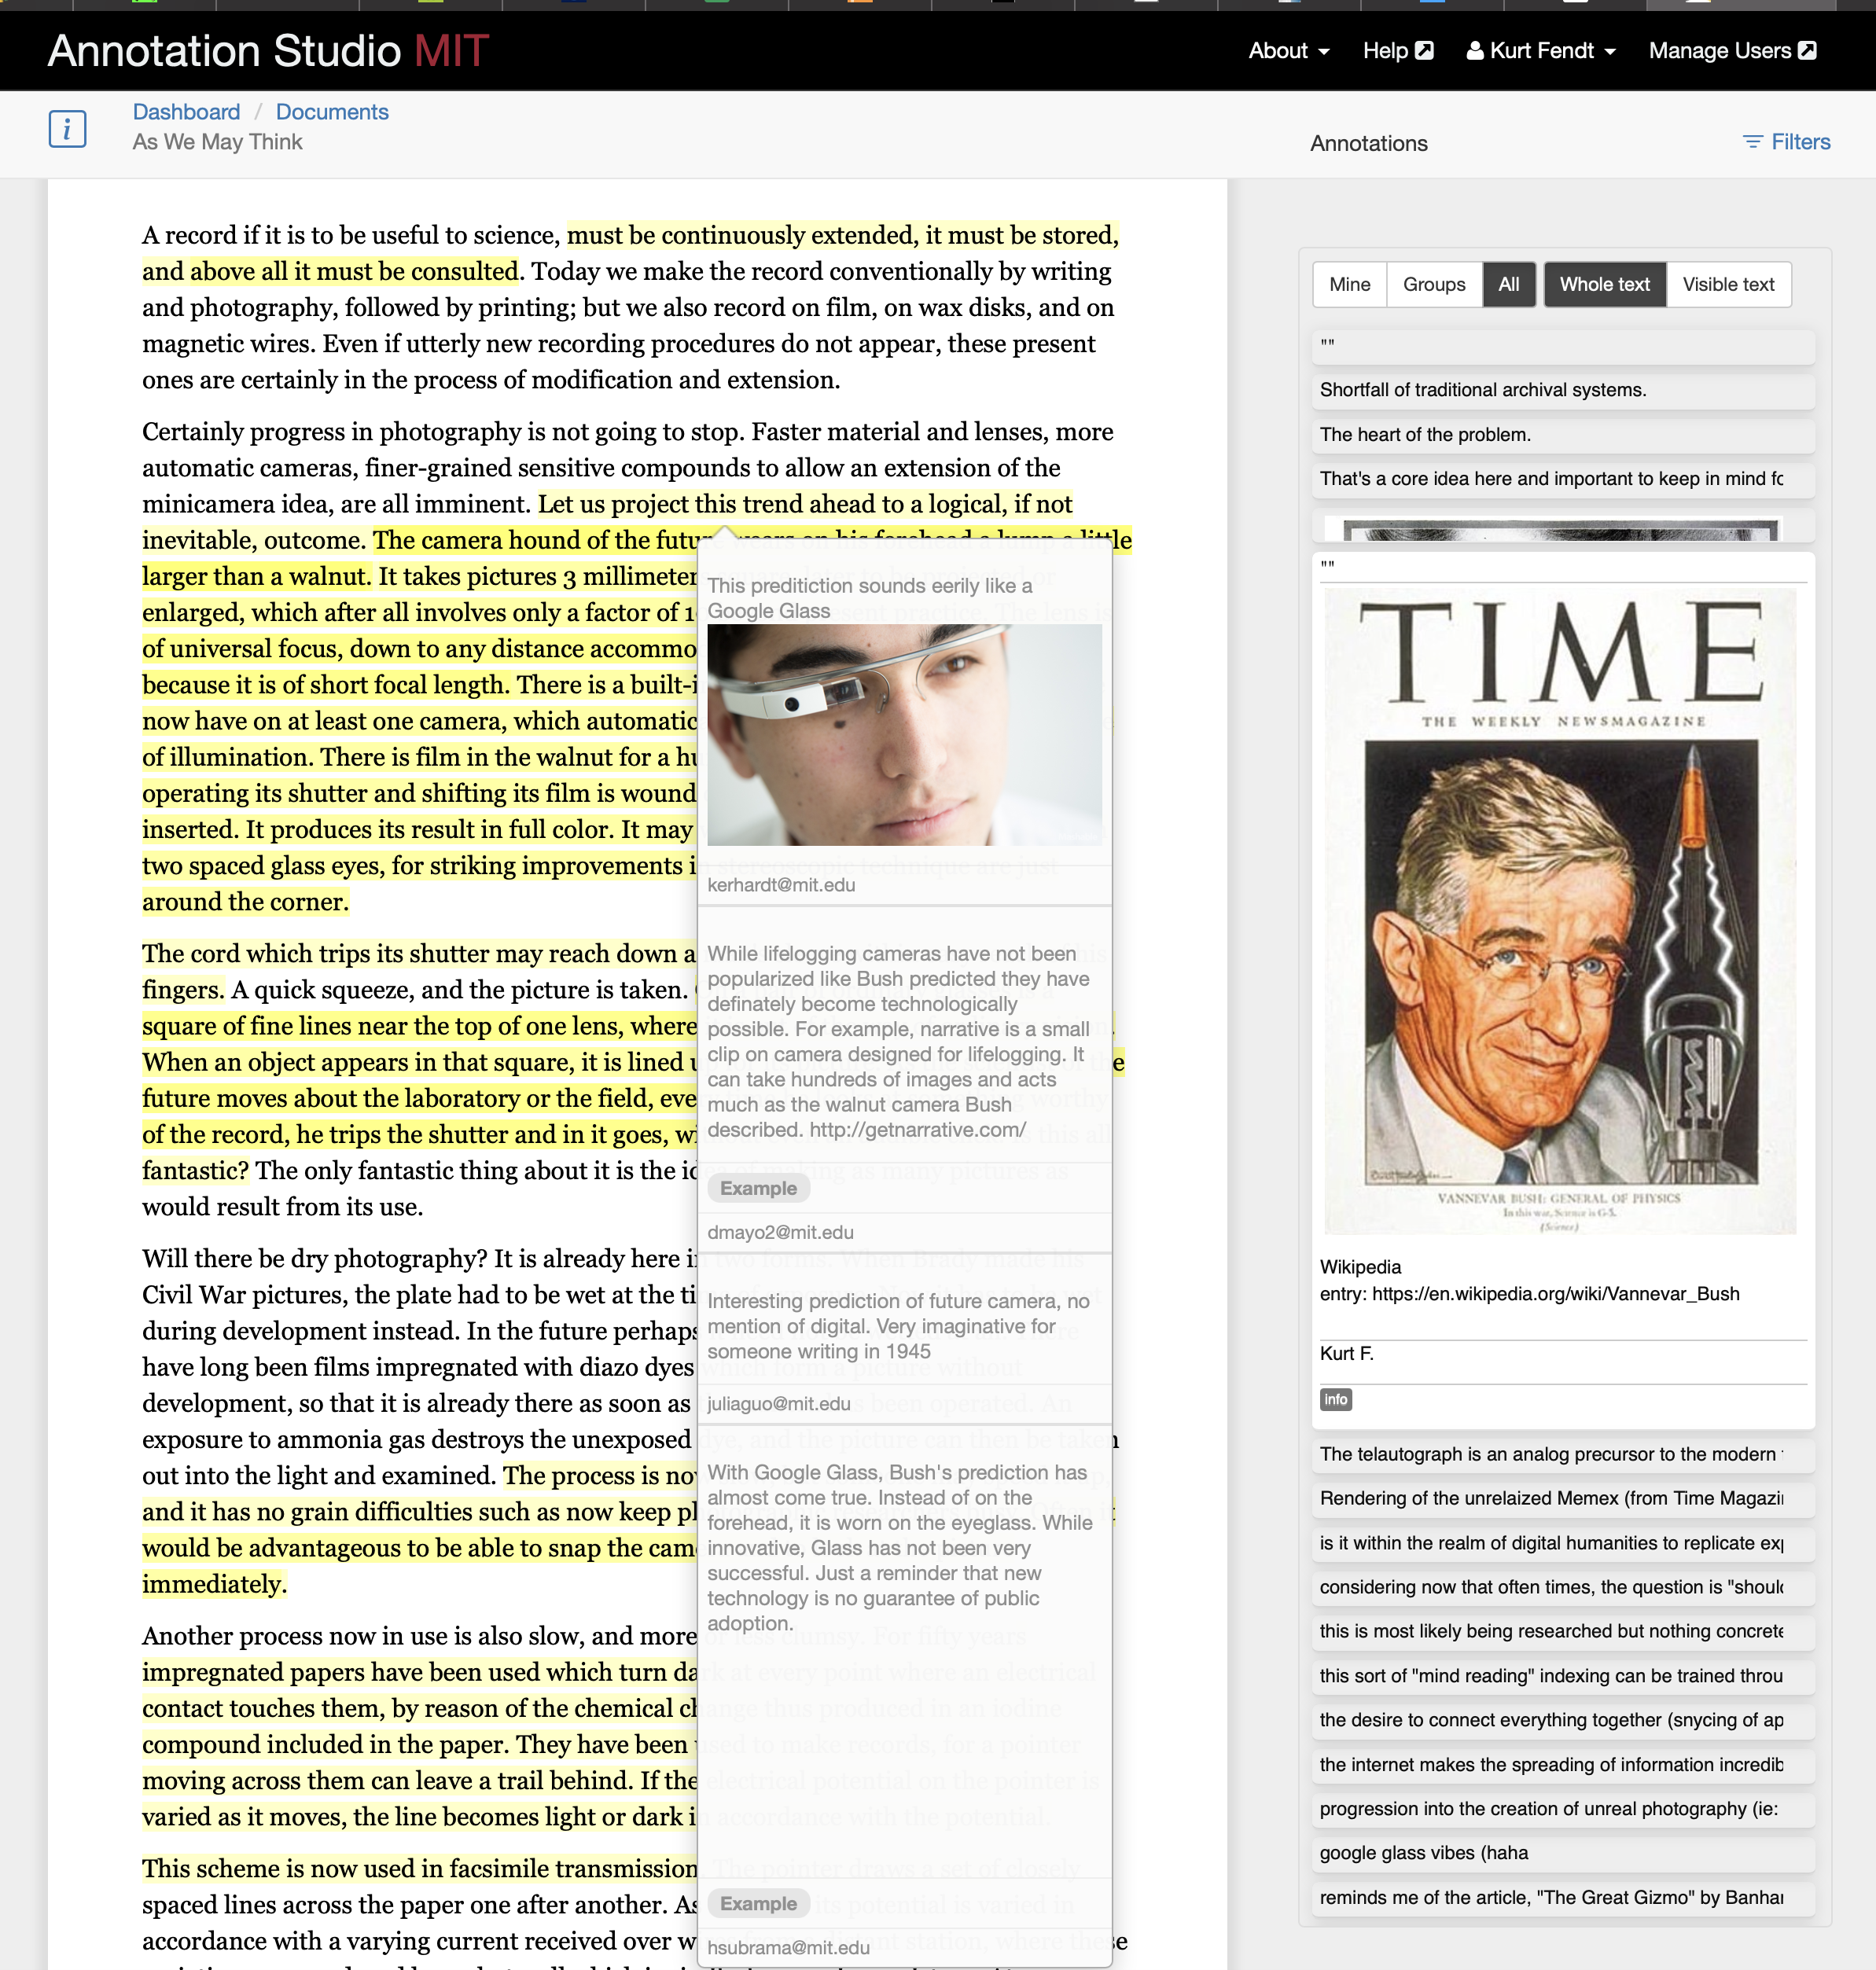

Slide 27
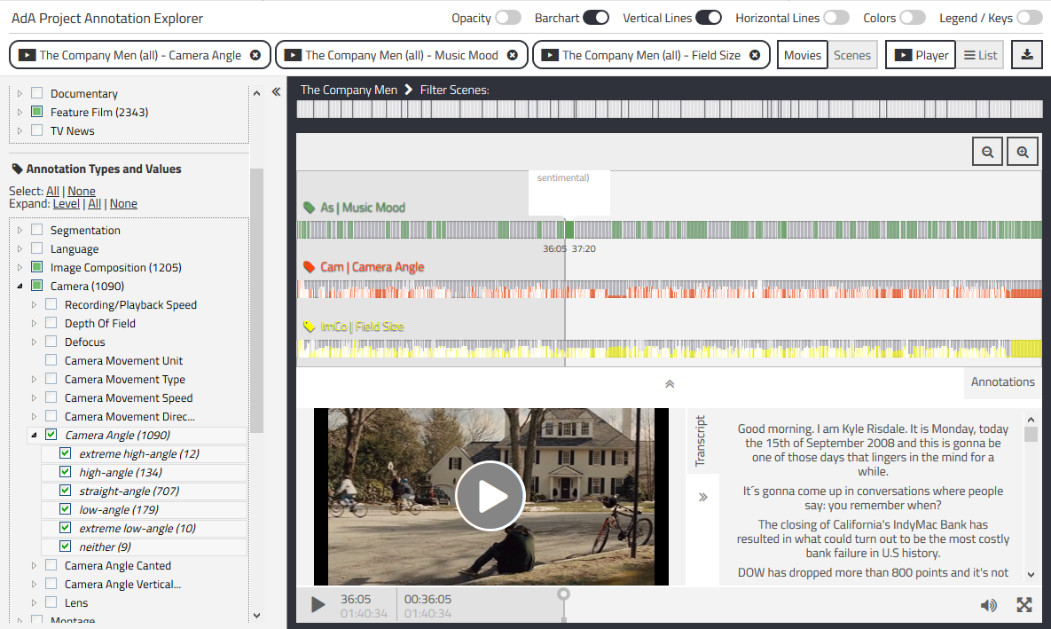
AdA Filmontology – A Machine-Readable Film Analysis Vocabulary For Video Annotation (https://github.com/ProjectAdA/public)

Slide 28
Making Reading
Visible.
Annotations make the reading and thinking process visible.

Slide 29
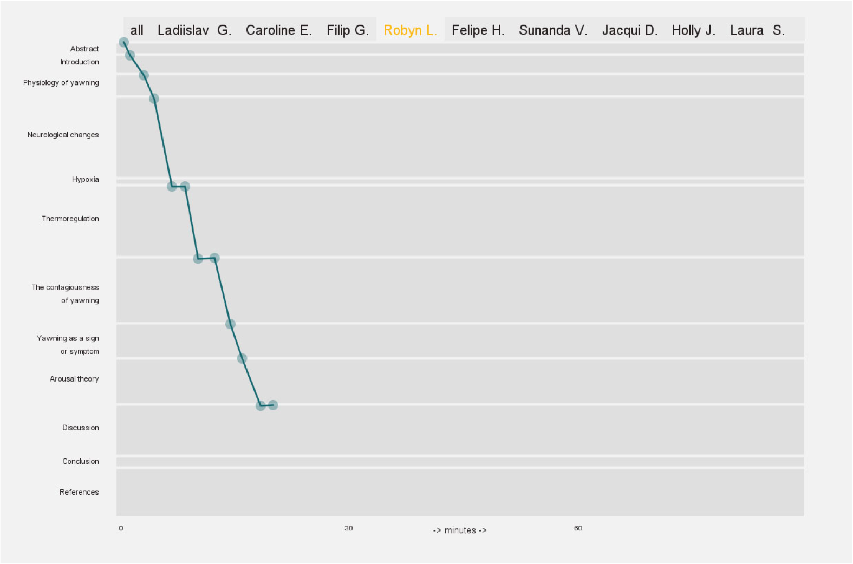
Reading & Annotating Process - Student 1

Slide 30
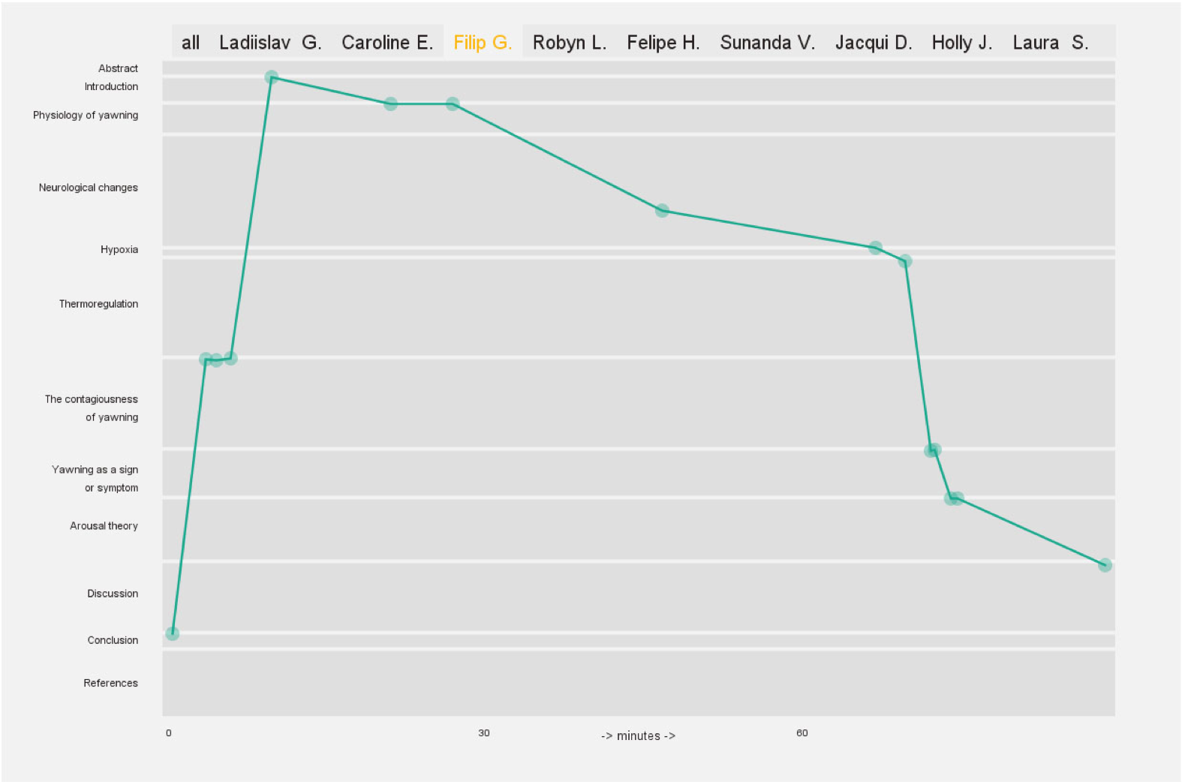
Reading & Annotating Process - Student 2

Slide 31
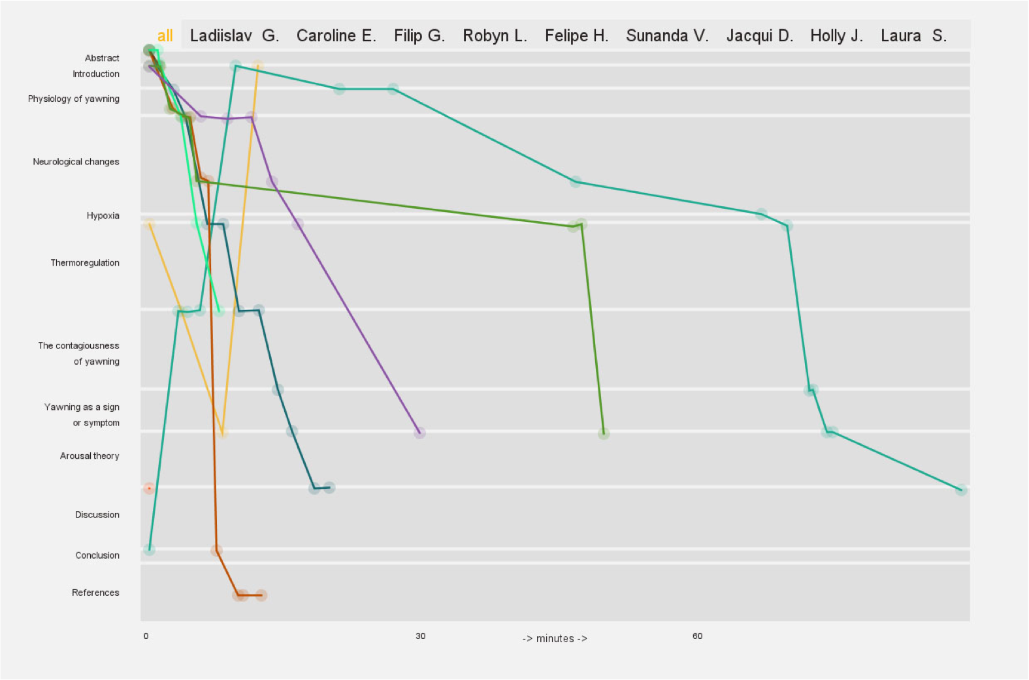
Reading & Annotating Process - Student Comparisons

Slide 32
2. Pedagogical Value of
Annotation
Let’s have a look at the
Levels of Engagement.
“Opening” of Texts
Connections between writing & learning

Slide 33
Textual
Engagement
“I have never annotated before. But I think I am getting better. I am actually writing down ideas while reading. By writing them down, I am actually looking deeper into the text, not like when I just read the book or something and said, ‘Oh it may mean this.’ Now it is more like, ‘Oh what does THIS mean?’ Then I keep asking questions because I am annotating. I am thinking about the text more.”
Student in a Fall literature class

Slide 34
Annotating is a
Core Activity.
Making annotations is a central activity of knowledge production and meaning making.

Slide 35
Scholarly
Primitives
(John Unsworth)
                “ I’m using the term “primitives” in a self-consciously analogical way, to refer to some basic functions common to scholarly activity across disciplines, over time, and independent of theoretical orientation.“
                John Unsworth
Discovering | Annotating
Comparing | Referring
Sampling | Illustrating
Representing

Slide 36
Annotations allow new Forms of Engagement.
Annotations prepare students to become better writers and experiment with scholarly practices.

Slide 37
Student
Engagement
                Students as “editors”
                Gloss unfamiliar words and references, opening up primary texts for new readers
                “Editing” less intimidating than “writing,” makes good writers
                Annotation as a first stage of the editing process; makes reading visible, writing purposeful
                Goal: to make the text your own
                Can work alone or in groups or with the whole class
                Close reading in a protected space
                Students as “scholars”
                Learn research tools in the field
                Create communities around a central subject
                Generate new ways of thinking, looking at materials
                Take risks, tolerate ambiguity, and invite failure
                Collaborate, thereby nurturing individual growth and development of a field

Slide 38
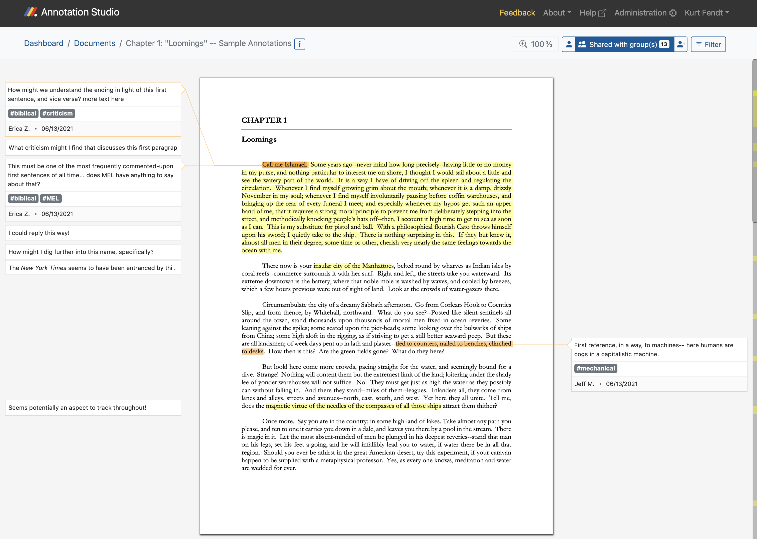
Chapter 1 of Moby-Dick on Annotation Studio by Active Archives Initiative , MIT

Slide 39
Annotating – a Practice for Diverse Audiences.
Annotations allow inexperienced readers/students to become familiar with the reading process.

Slide 40
Community
College
                Developing Reading Versatility
                Gain awareness of the recursive process of reading, as well as the connection between reading, thinking, and writing.
                Respond authoritatively in writing to a published text.
                Engage with the ideas of peers in a non-threatening, non-distracting digital environment.
                Communicate within the parameters of a shared digital space.
                Establish a transferable reading routine that includes not only annotation but the consideration of other readers’ ideas.

Slide 41
3. Annotation in the
Classroom
Let’s look at three case studies:
- English Literature
- Foreign Language Studies
(Spanish)
- Film Studies

Slide 42
Close Reading of English Literature.
Students examine terms, phrases, objects, language use.
They speculate on interpretations, categorize their thoughts through tags.
They “inscribe” their understanding into the text by offering ideas to fellow students for further discussion online or in the classroom.

Slide 43
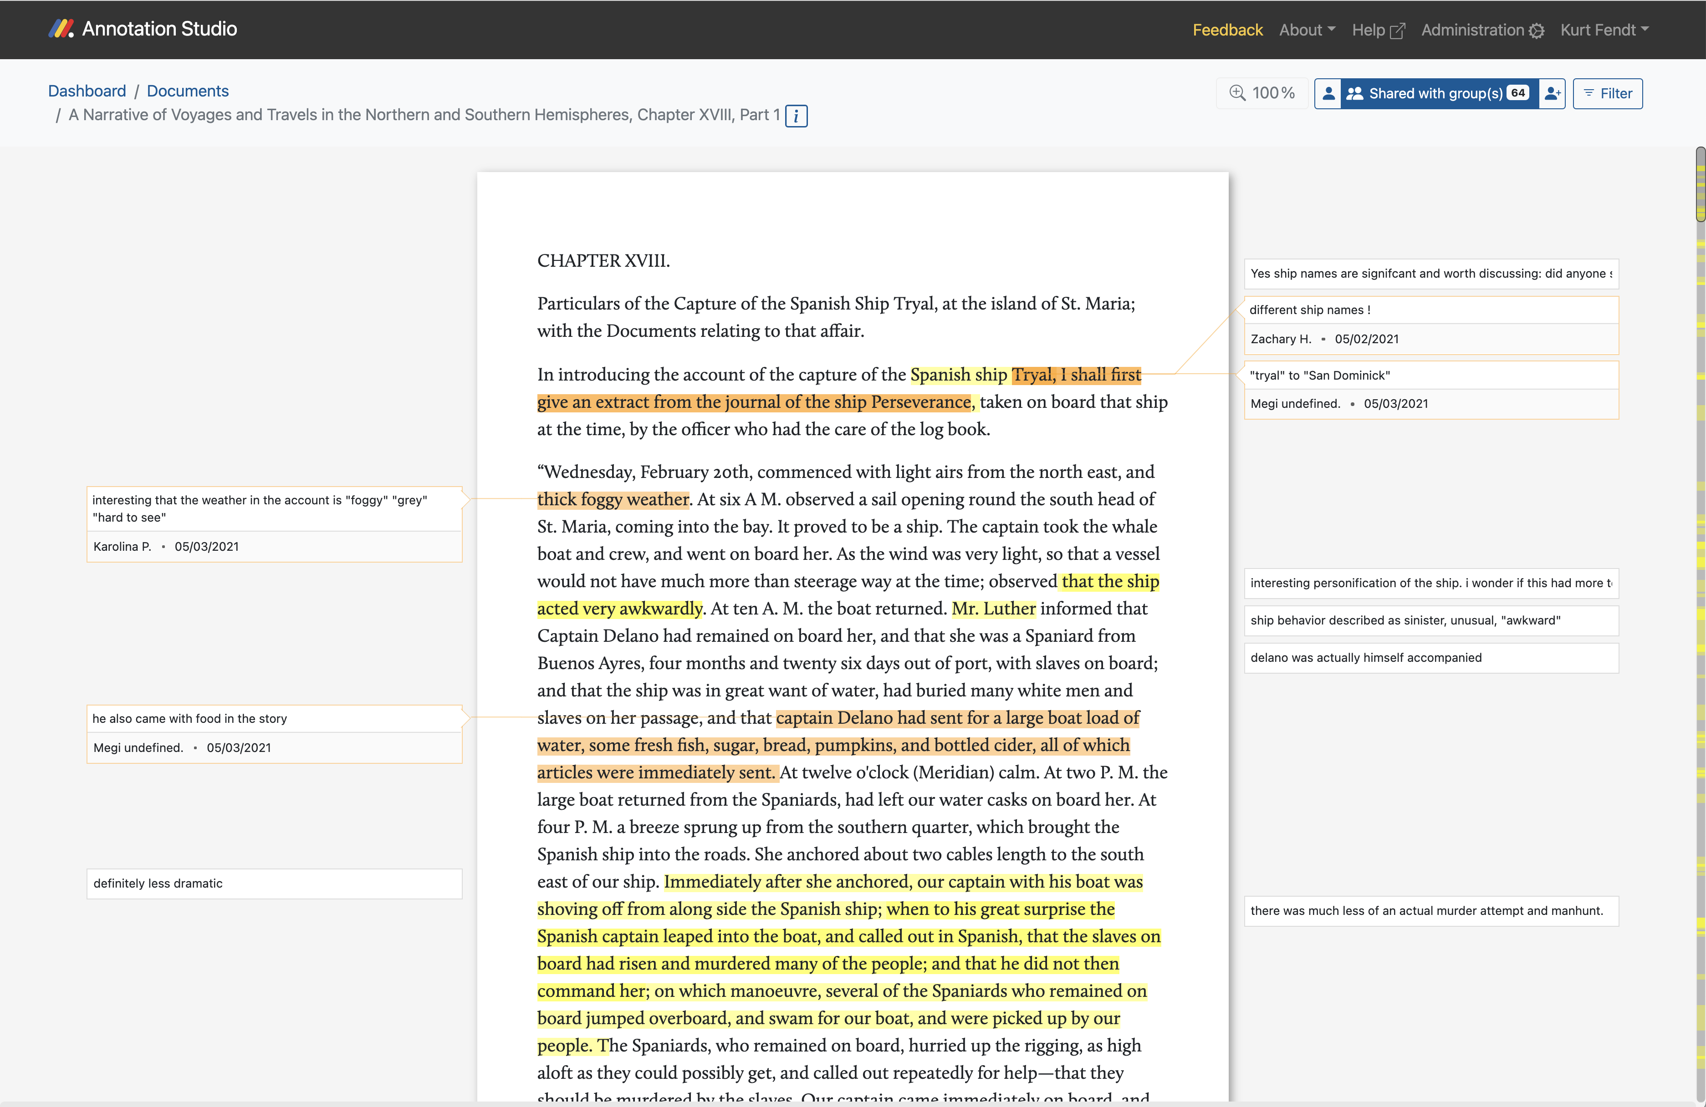
Amasa Delano “A Narrative of Voyages and Travels in the Northern and Southern Hemispheres, Chapter XVIII, Part 1” (1818)
on Annotation Studio by Active Archives Initiative , MIT

Slide 44
Annotating in a
Foreign
Language.
Annotating combines several skills and activities in the target language.

Slide 45
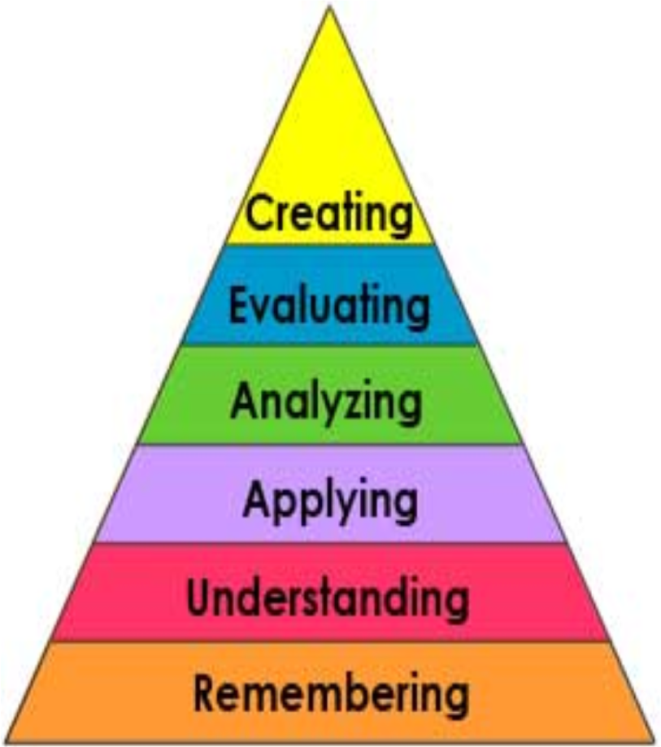
Foreign
Languages
                Spanish Language Education
                Develop reading and writing proficiency in the target language
                Turn reading assignment into communicative act: writing, student-instructor, student-student
                Accountability for preparation work

Slide 46
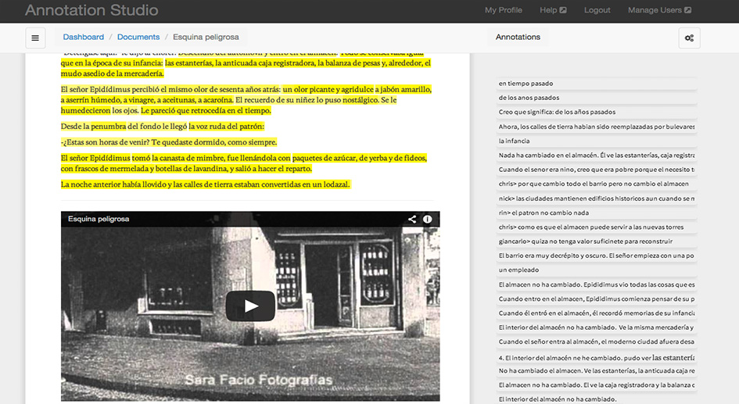
Marco de Nevi: Esquina peligrosa
Annotation Studio (Version 1) by Active Archives Initiative , MIT

Slide 47
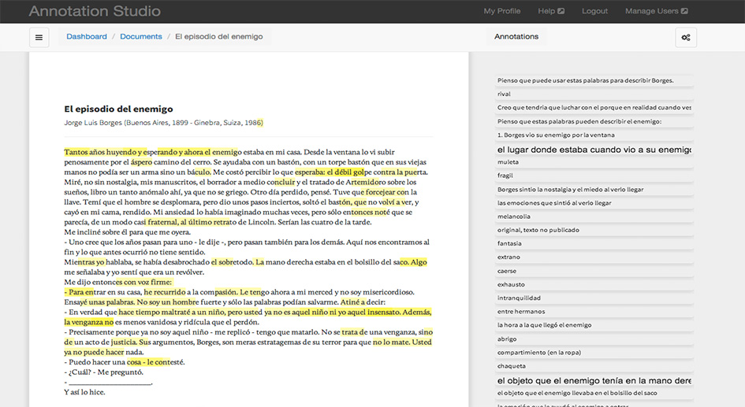
Jorge Luis Borges: El episodio del enemigo
Annotation Studio (Version 1) by Active Archives Initiative , MIT

Slide 48
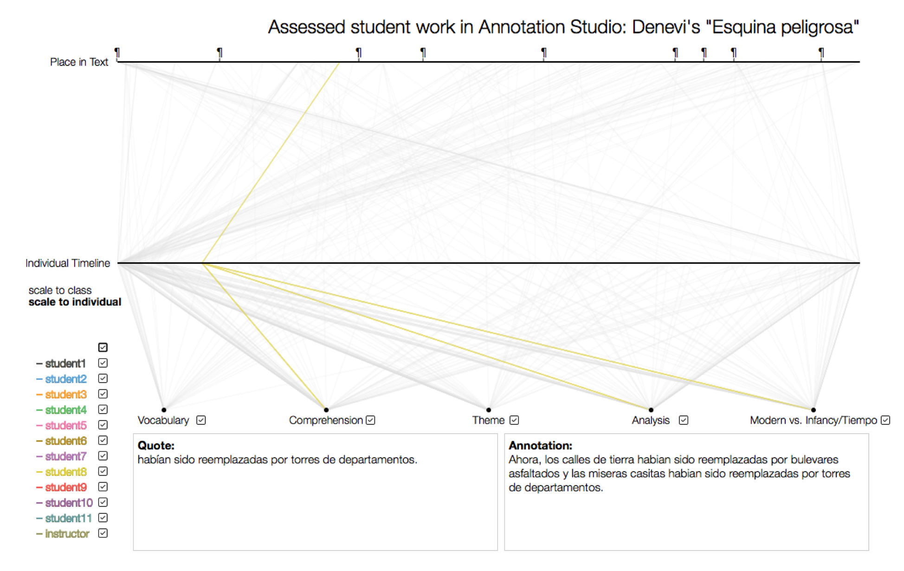

Slide 49
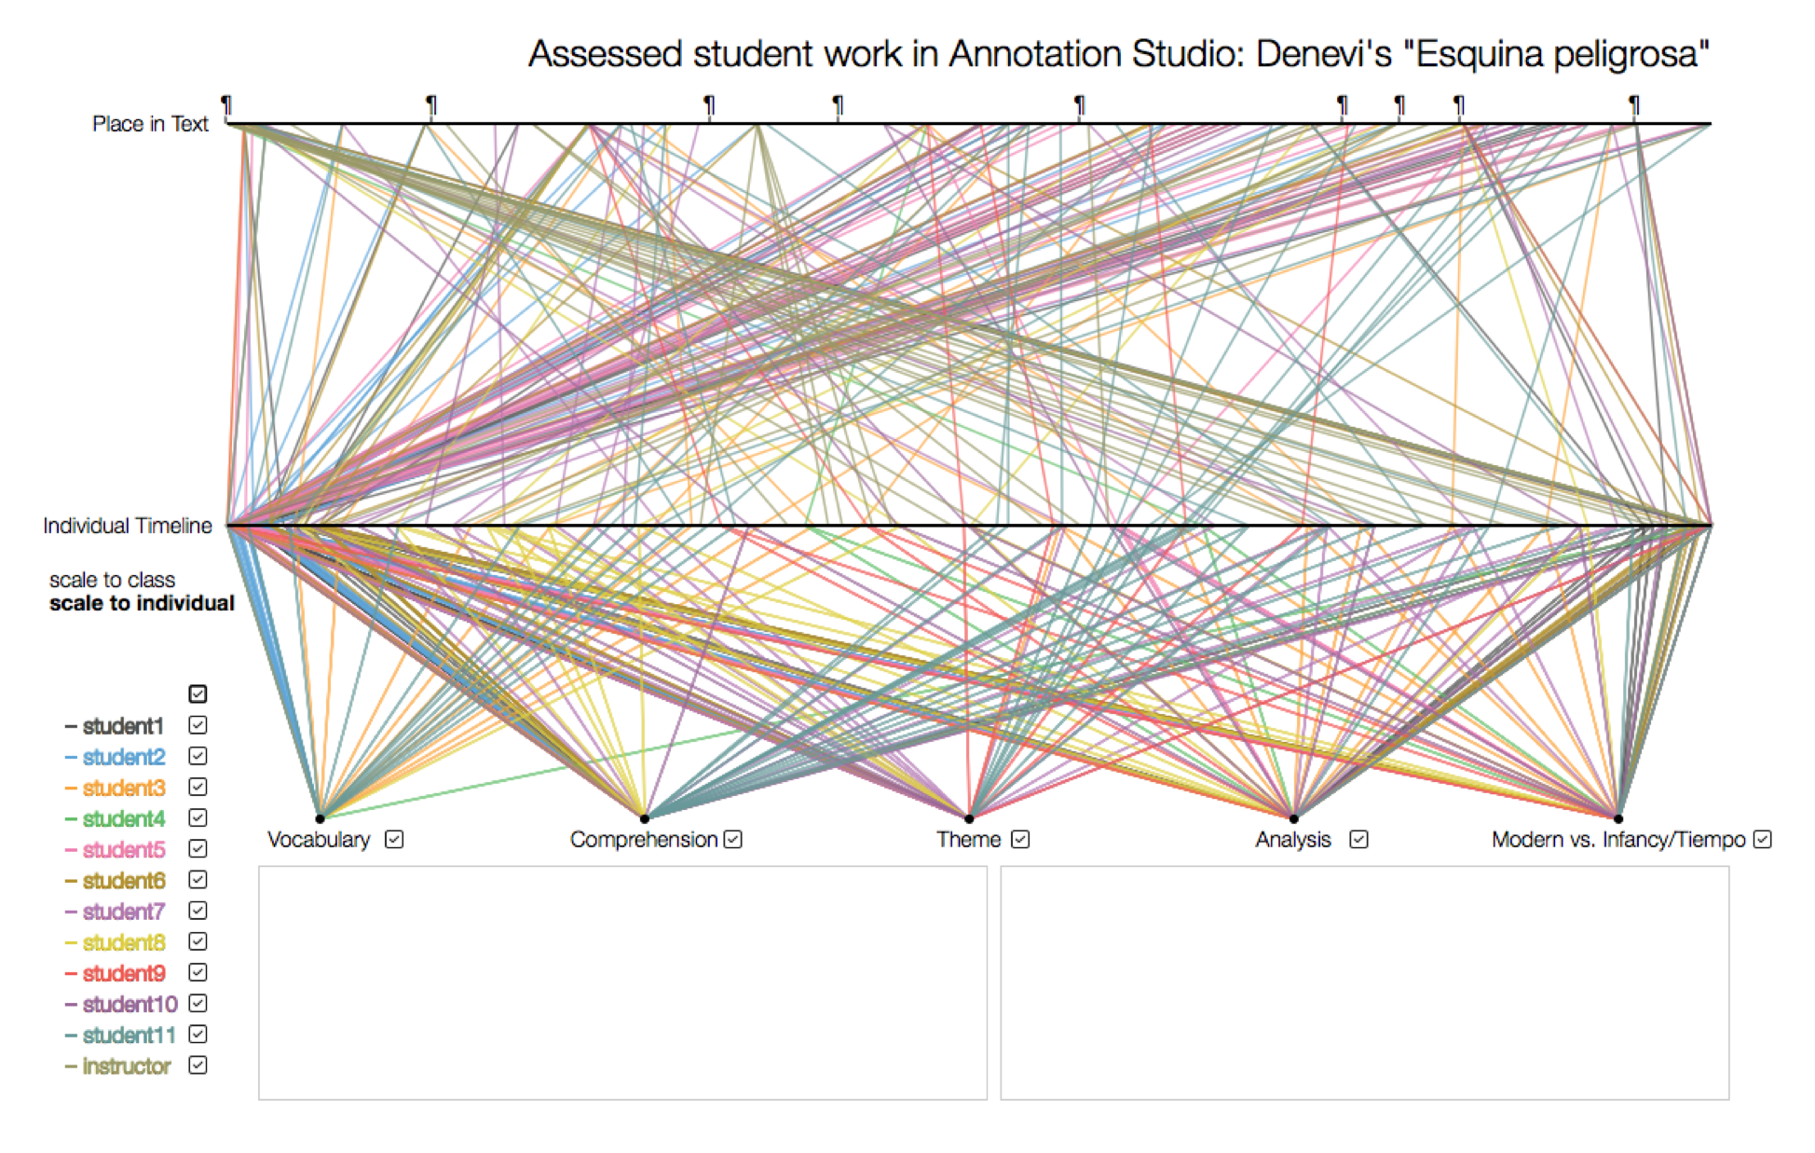

Slide 50
Annotations allow Close Reading in
Film Studies.
Annotating engages students in the detailed analysis of film sequences and understand the many layers of meaning, form, and narrative.

Slide 51
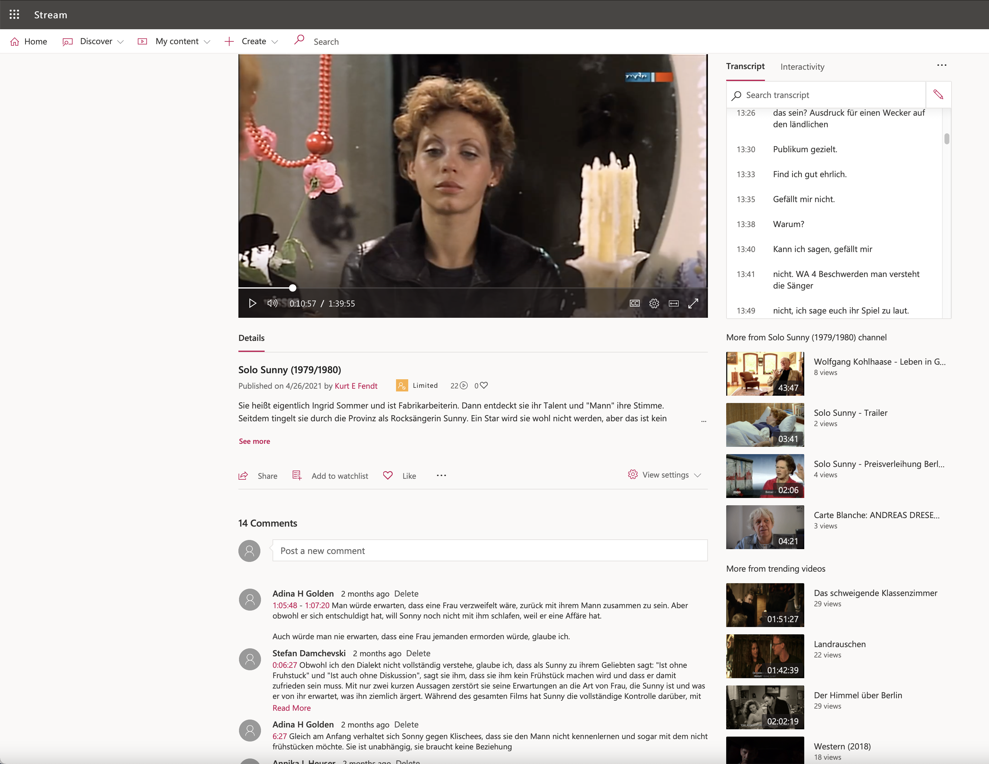

Slide 52
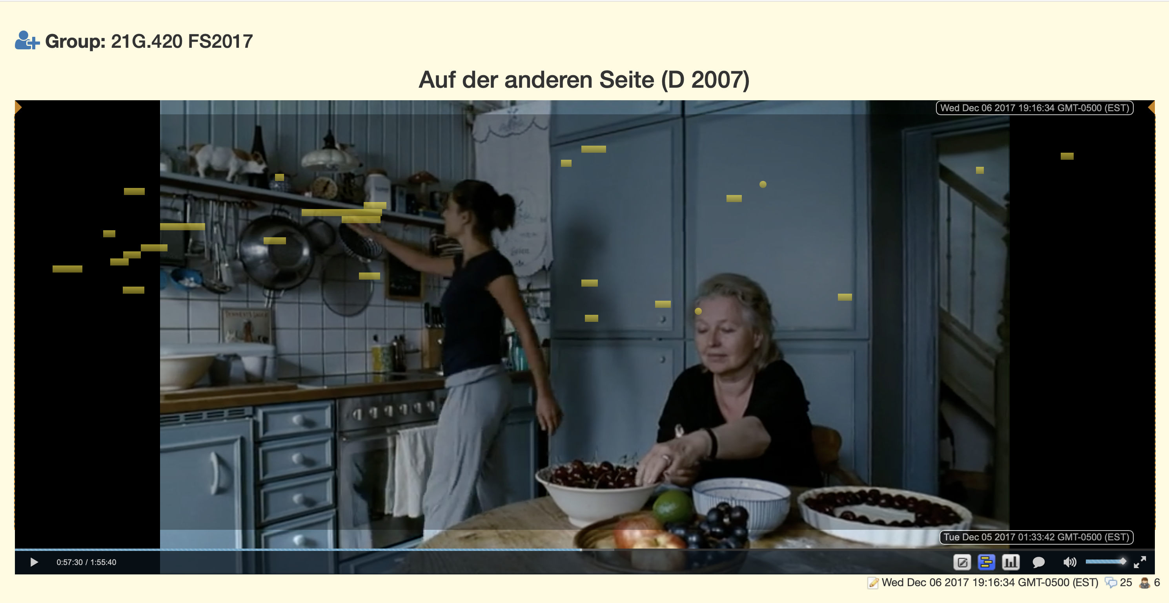
CoAnnotation by Daniel Cebrián Robles

Slide 53
Annotation Platforms.
Over the past years, many annotation platforms have emerged as web apps, stand-alone applications, integrated into Learning Management Systems (LMS), free and subscription-based.
Here are just a few.

Slide 54
Annotation Platforms
Annotation Studio (MIT) - free, upload of texts
annotationstudio.org
hypothes.is - free, any text on the web
MarginText - fremium (Mac & iOS)
Perusall - freemium, integrated with textbooks
CommentPress - free, Wordpress Plug-in
Edji/Hero - freemium, web-based

Slide 55
Annotation Studio.
A quick functional overview.

Slide 56
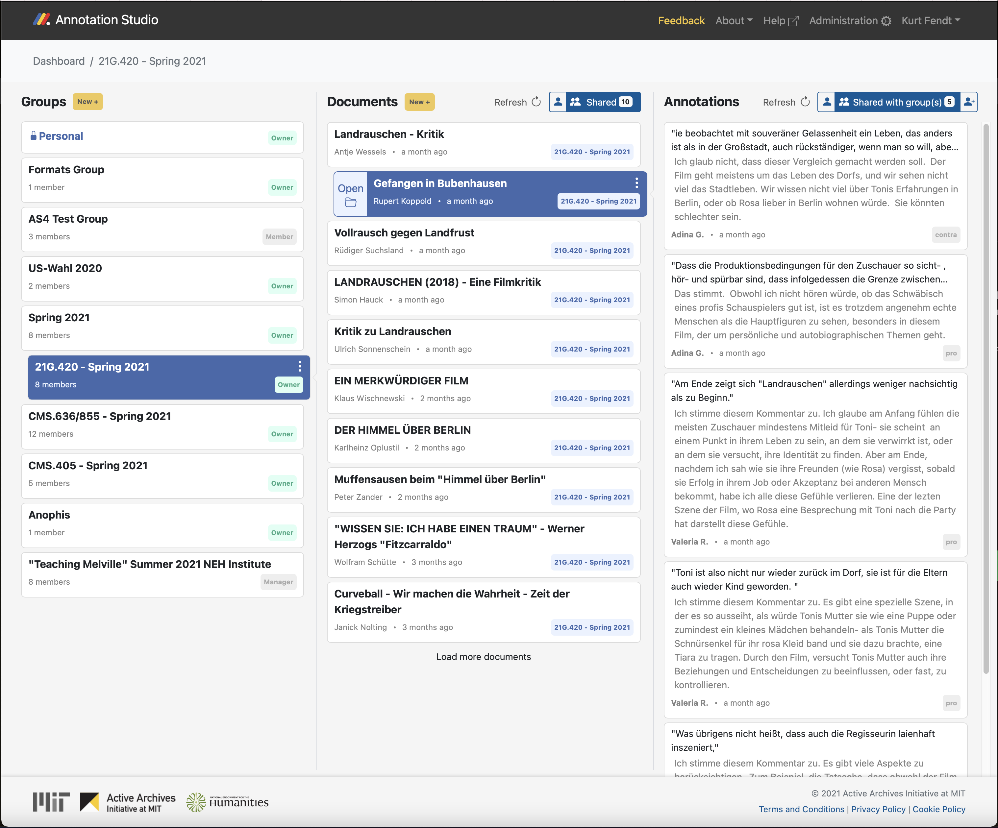
CoAnnotation by Daniel Cebrián Robles

Slide 57
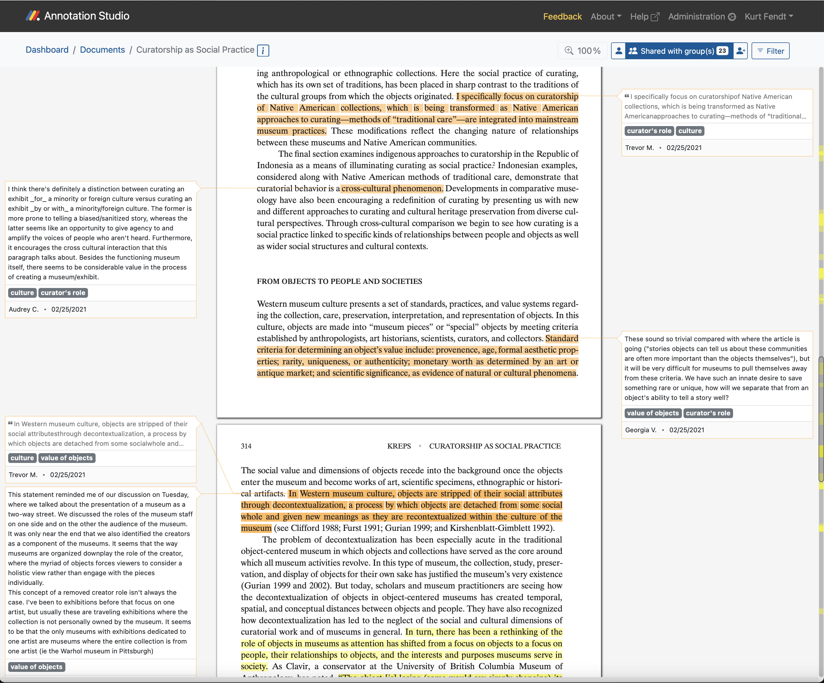
CoAnnotation by Daniel Cebrián Robles

Slide 58
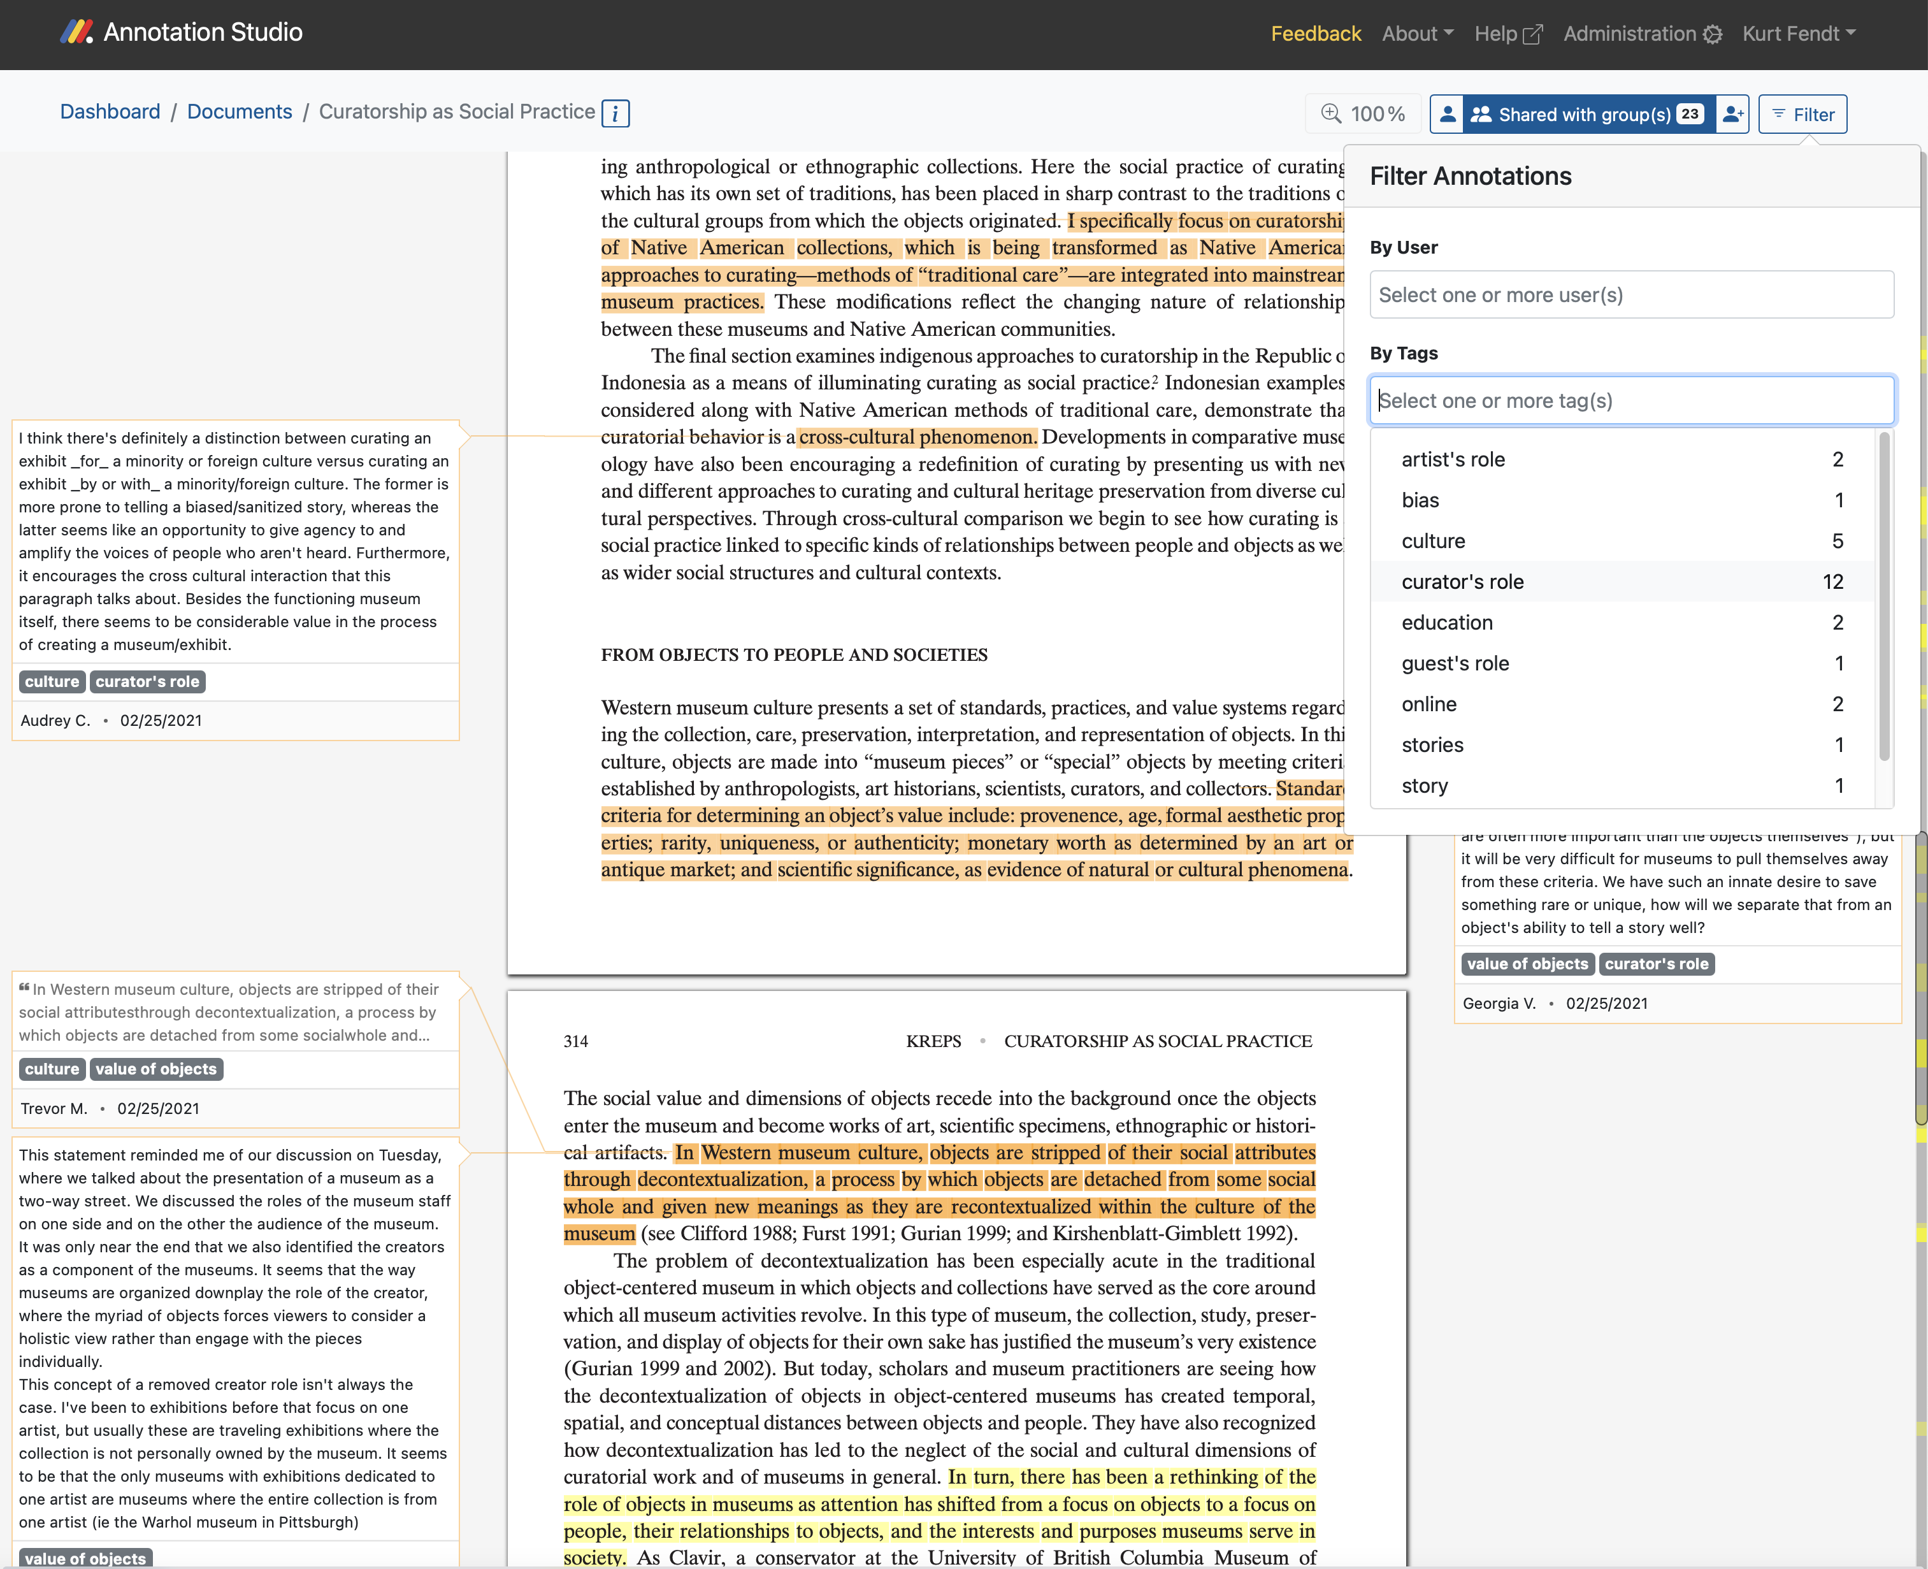

Slide 59
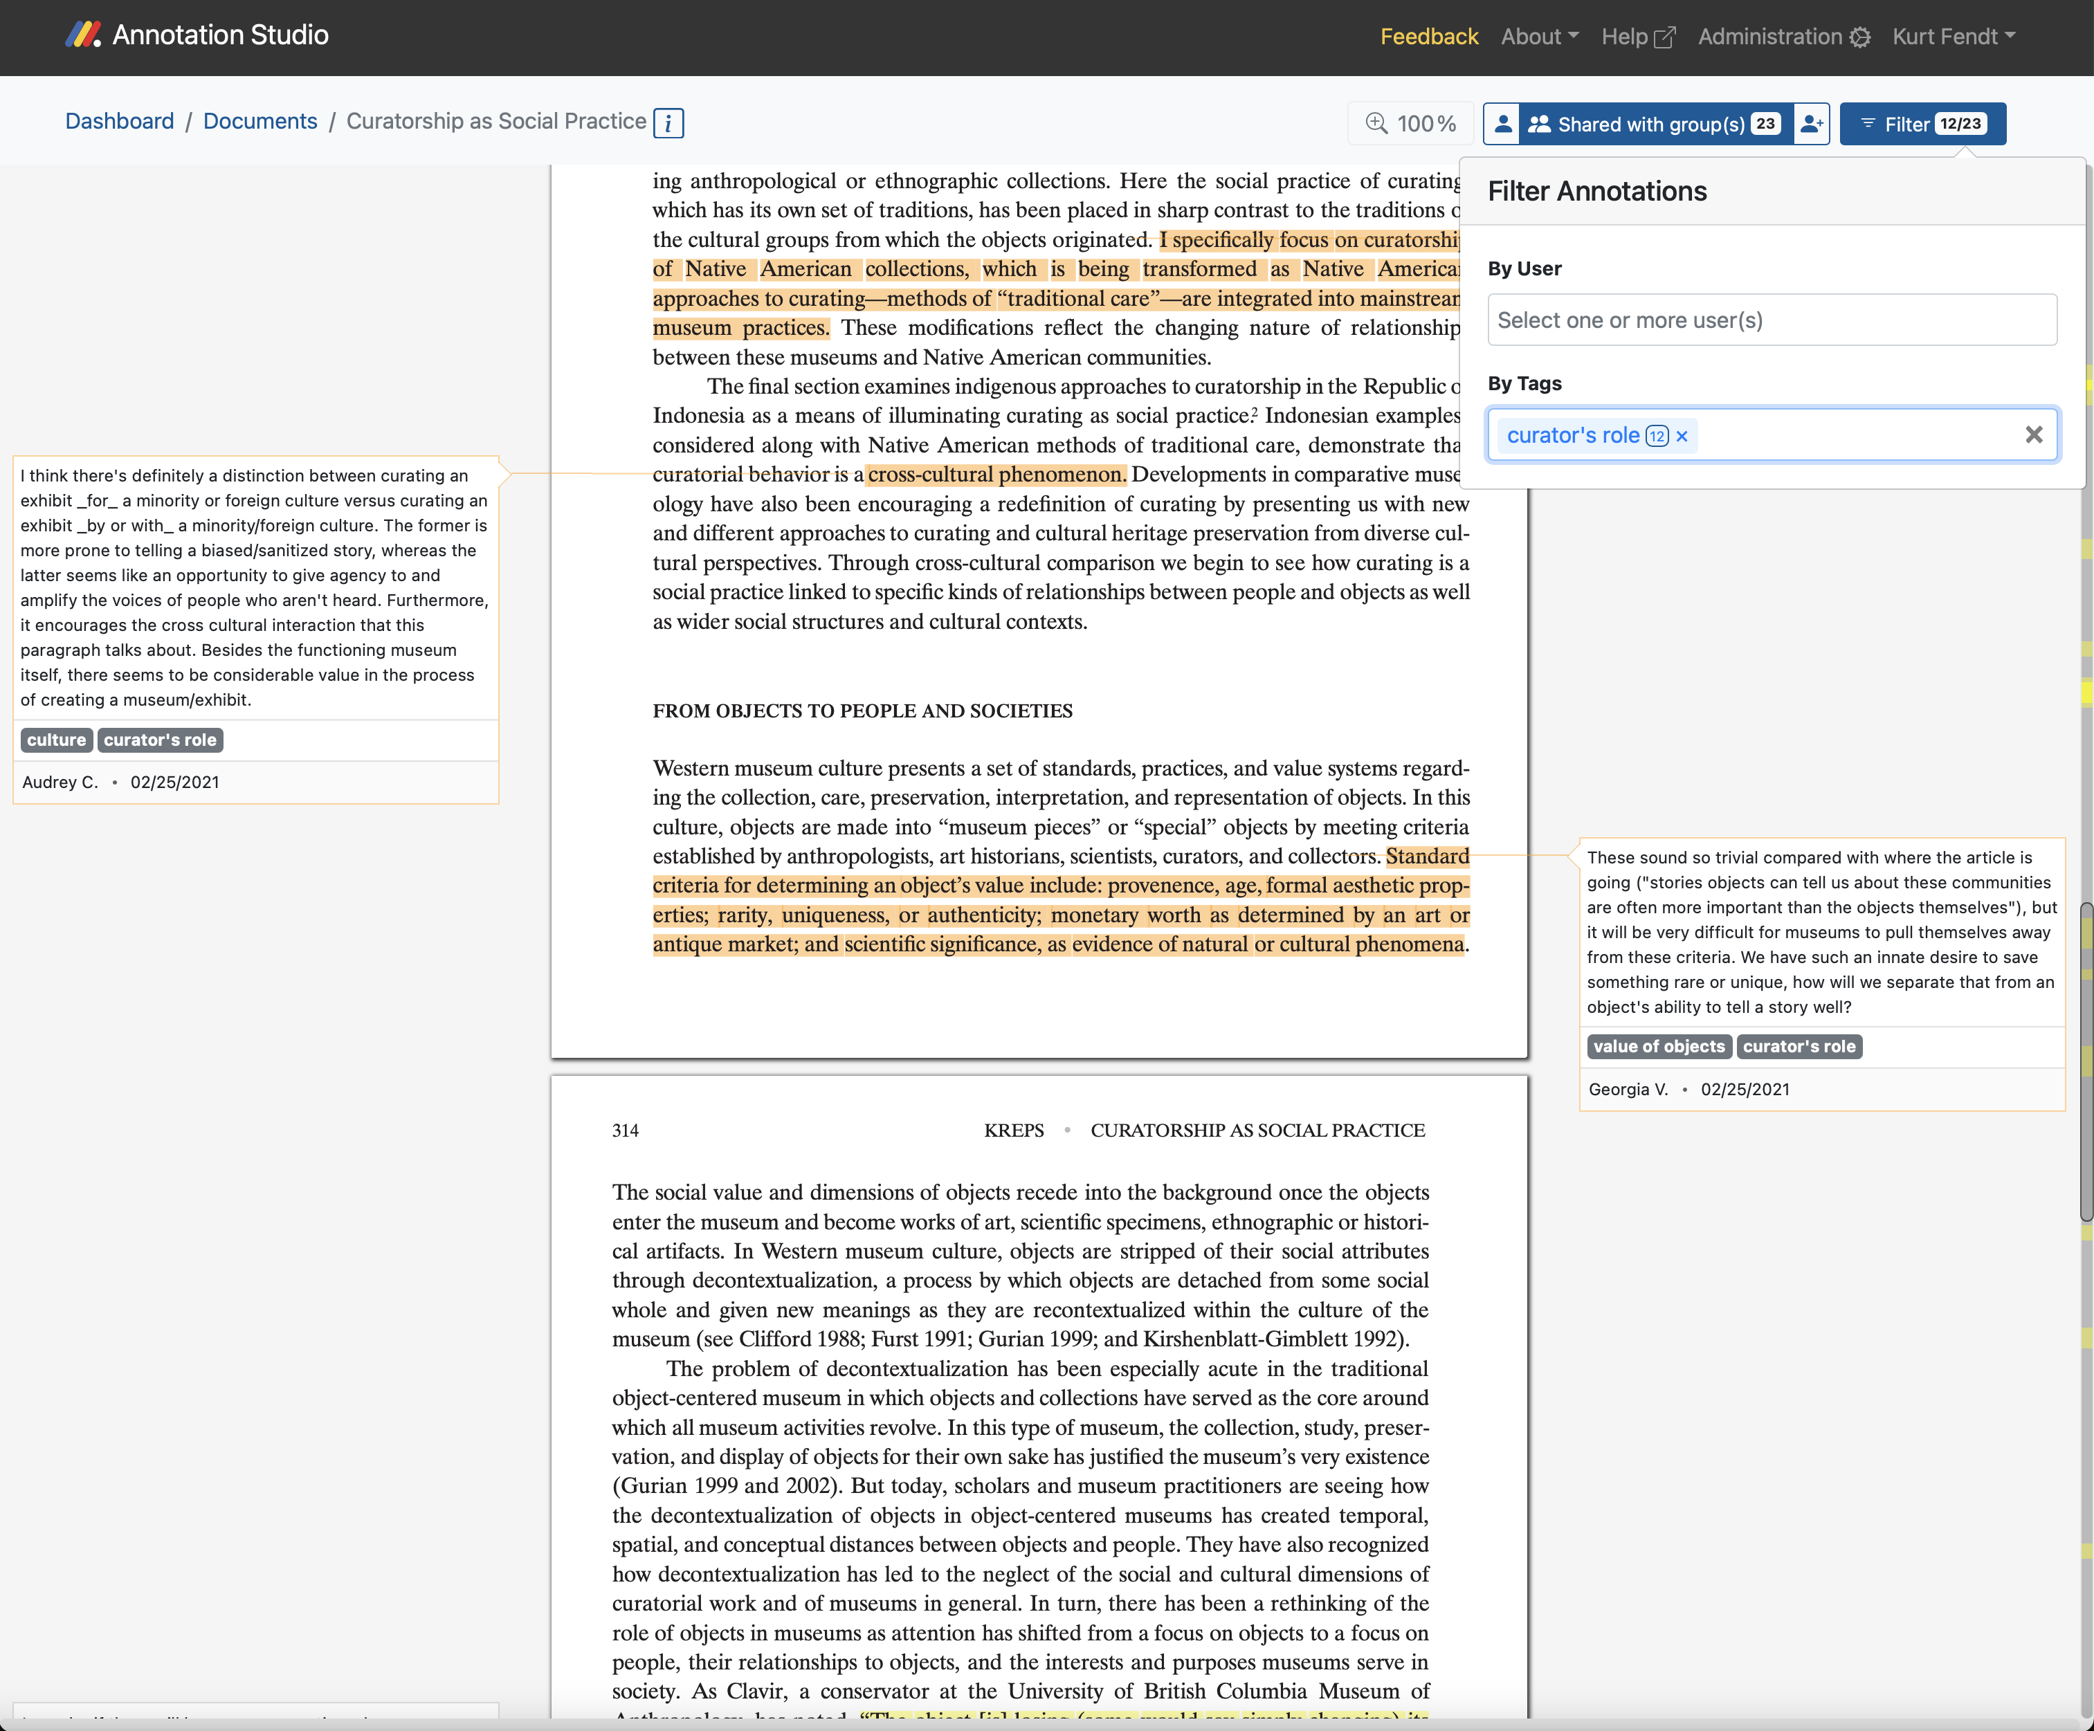

Slide 60
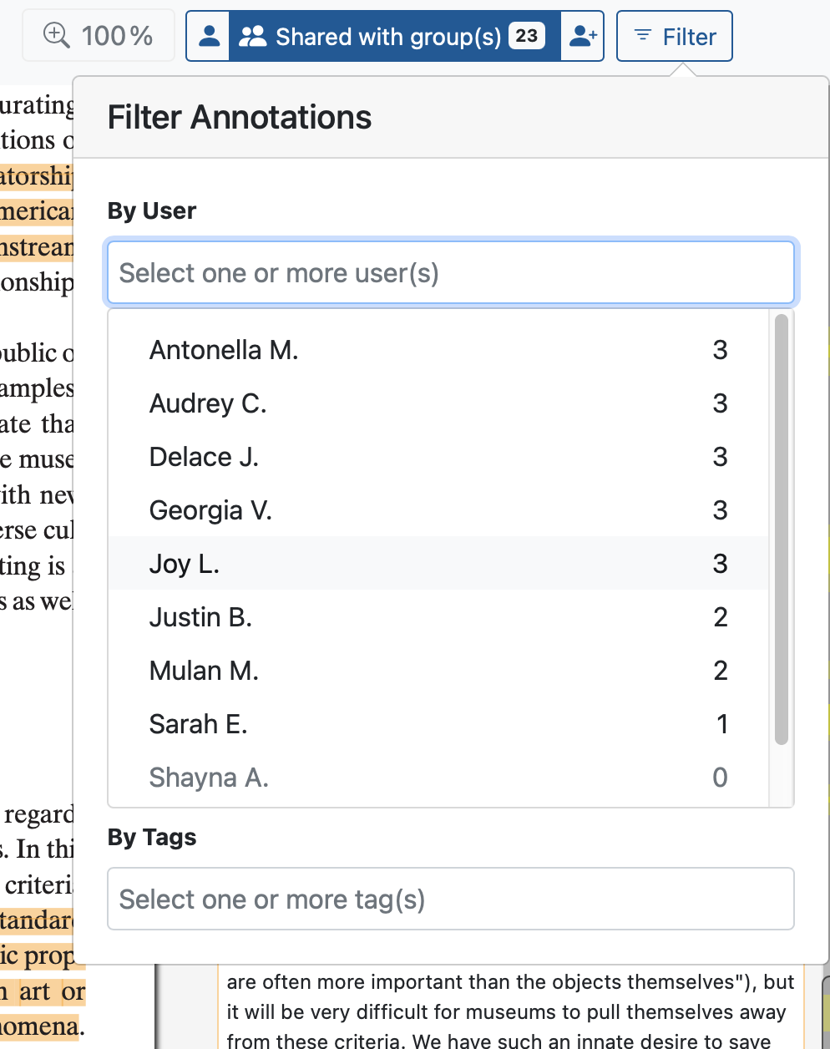

Slide 61
4. Beyond Annotation
Let’s briefly look at the
Reading – annotation – writing cycle.
Self annotation
Discussion of pedagogical uses in the classroom

Slide 62
Developing Critical Skills.
Students need to develop a degree of competence and sophistication in using critical analysis skills to be able to communicate their own meaningful ideas.
Reading, thinking, and writing are interconnected processes.

Slide 63
Develop Writing Skills.
Effective academic writing for an audience necessarily involves a two-step process:
1. identifying what to say.
2. working on how to say it.

Slide 64
Develop Critical Self-Reflexivity.
Introspective way of reading their own work, a metacognitive engagement involving re-reading their writing that opens up an inner dialogue about what they think of their work and how others will perceive it.
Self-Annotation as a means of promoting critical self-reflexivity.
Kerrigan, John. “Using Self-Annotation as a Tool for Promoting Reflexivity in Critical Analysis Writing.” Interdisciplinary Humanities, vol. 34, no. 3, Humanities Education & Research Association, 2017, pp. 53–69.

Slide 65
Idea Space & Annotation Studio, MIT, Active Archives Initiative, 2020

Slide 66
Thanks!
¡Muchas gracias!
#annotateMIT
@fendt | fendt@mit.edu
annotationstudio.org
#WEBINARSUNIA
@UNIAINNOVA @UNIAUNIVERSIDAD

